Slide 1
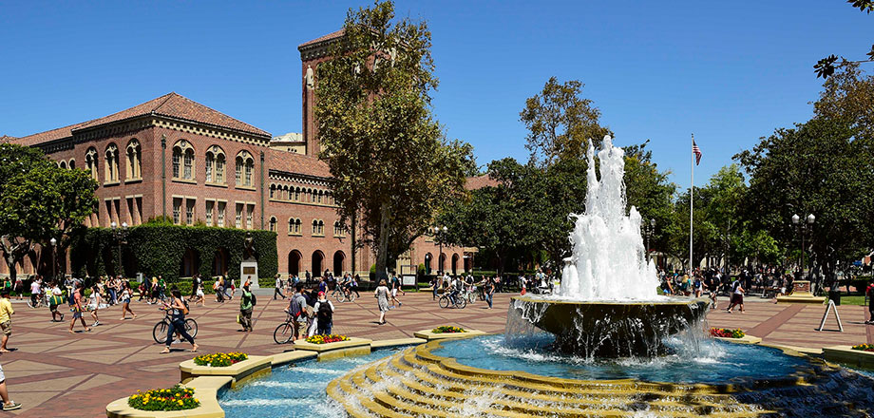
Code.org Lessons 11 & 12
Lesson 11- Packets and Making a Reliable Internet
Lesson 12- The Need for DNS

Slide 2

Today
Quiz- Lessons 9 & 10
Lessons 11 & 12

Slide 3


Slide 4
Packets and Making a Reliable Internet
Unit 1- Lesson 11

Slide 5
Today
The Internet Simulator has been setup for this lesson to restrict messages to no more than 8 characters each, and messages get dropped messages with some probability on every hop
Develop your own protocol
TCP - Transmission Control Protocol - provides reliable, ordered, and error-checked delivery of a stream of packets on the internet. TCP is tightly linked with IP and usually seen as TCP/IP in writing

Slide 6
Internet Simulator= Set-Up
On the real Internet packet sizes are limited, and transmission is unreliable
Restrict packet-size to be very small - 16-bits for the to and from addresses plus only 8 ASCII characters
Also, the Simulator drops packets pretty regularly. In a set of 10 messages it’s very likely one or two will be dropped
These types of constraints are a very real problem on the Internet

Slide 7
Internet Simulator- Challenge
The Challenge--
How to use the 8-ASCII-characters-worth of data to include both a piece of message you’re trying to send
As well as information about how many messages (packets) there are in the whole message
And which number this packet is

Slide 8
Internet Simulator- Assignment 1
Assignment—
Invent your own Transmission Control Protocol- TCP
A small but non-negligible percentage of packets are lost in transmission because of faults in the infrastructure of the Internet
Larger messages are divided into many packets
Receiver will send an acknowledgement
If sender does not receive an acknowledgement, it will resend the packet until all packets have been acknowledged

Slide 9
Internet Simulator- Assignment Cont.
Assignment Continued—
Since packets may arrive out of order, additional data must be included to indicate the order in which the packets should be arranged
Thus, while individual packets cannot be guaranteed to arrive, eventually an entire message can be accurately reconstructed

Slide 10
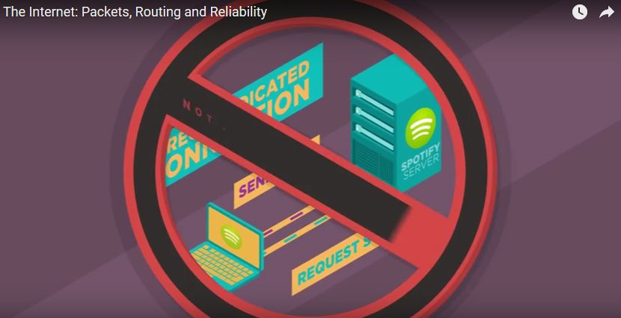
Code.org - Video
The Internet: Packets, Routing, and Reliability

Slide 11
Internet Simulator- Try It!
Let’s give it shot – Handout – Internet Simulator
In a group or individually join a router in the Internet Simulator and practice sending messages given these new constraints. Once you are comfortable with the challenge, iteratively design a protocol that can reliably send a message to a partner. You and your partner should join DIFFERENT routers.

Slide 12

Finish Code.org Lesson 11
Complete code.org Lesson 11

Slide 13
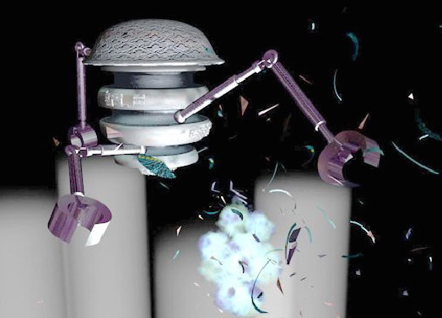
Video
Warriors of the Net

Slide 14
The Need for DNS
Unit 1- Lesson 11

Slide 15
Background
It would be impossible for packets to be routed across the internet without IP addresses
The problem with this system is that, while computers are good at referring to other computers by numbers, humans are not
The Domain Name System (DNS) solves this problem so that we can identify a webpage by its name, even when the IP addresses change.

Slide 16
DNS
Domain Name System
Internet’s system for converting alphabetic names into numeric IP addresses
Internet Simulator

Slide 17
Video
The Internet: IP Addresses and DNS (code.org)

Slide 18
DNS Activities
Activity- DNS Partner Questionnaire
Worksheet- Names and Addresses

Slide 19
Review Lesson 11
The challenges we encountered in today’s activity very closely mirror those that exist on the actual Internet.
The response was the development of a protocol called the Transmission Control Protocol, or more simply, TCP.
TCP divides larger messages into smaller packets which have ordering information added to their header.
When a packet arrives at a destination computer, an acknowledgement is sent to the sender, letting them know they don’t need to resend that packet.
Once all the packets have arrived, the ordering information in the headers of the packets allows them to be reordered to create the original message.

Slide 20
Review Lesson 12
Why does the Internet use IP addresses?
Why don’t we need to know IP addresses?
Why do we need a Domain Name System?
Why don’t we all maintain our own DNS?
Is there one big DNS for the entire Internet?
How do you think all these DNS servers are maintained?

Slide 21
The End
What should be in your journal?
Upcoming Unit 1 Test!!!

